Slide 1
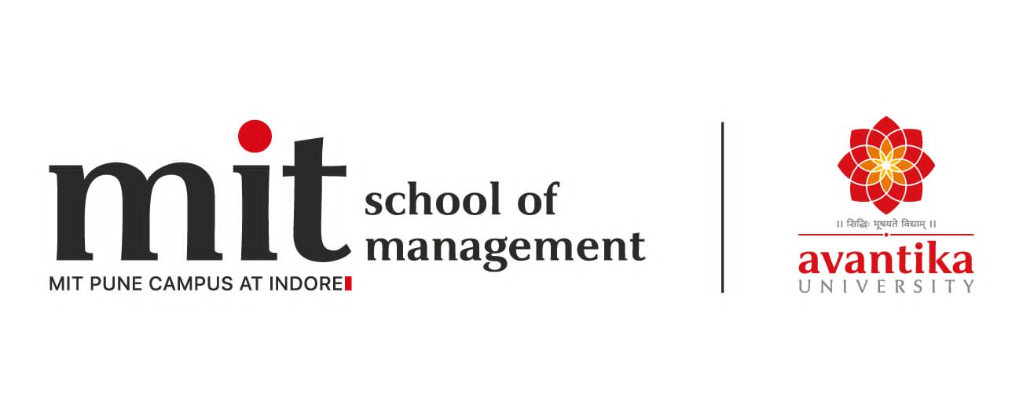
Case Study on
Energy from waste
BBA 2nd SEM (2022-23)
Submitted By-
Shankh Bansal
AU22C1013
Submitted To-
Dr. Manesh Patil

Slide 2
What it means?
Waste-to-energy technologies convert waste matter into various forms of fuel that can be used to supply energy. Waste feed stocks can include municipal solid waste (MSW); construction and demolition (C&D) debris; agricultural waste, such as crop silage and livestock manure; industrial waste from coal mining, lumber mills, or other facilities; and even the gases that are naturally produced within landfills.

Slide 3
Why waste to energy?
Waste-to-energy technologies can address two sets of environmental issues at one stroke - land use and pollution from landfills, and the well- know environmental perils of fossil fuels. However, waste-to-energy systems can be expensive and often limited in the types of waste they can use efficiently; only some can be applied economically today.

Slide 4
Waste utilisation
Scrap metals are now almost systematically extracted from the bottom ash. Metal quality is very high and rising market prices mean good income stream for operators.
Reusable bottom ash is a useful construction material. Using it offsets the need to extract raw materials, which has considerable environmental impacts. It is disposed of when no demand exists or if waste contaminated it.

Slide 5
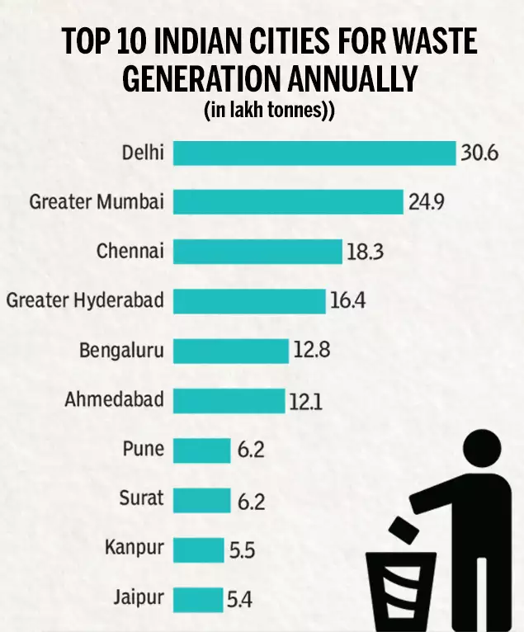
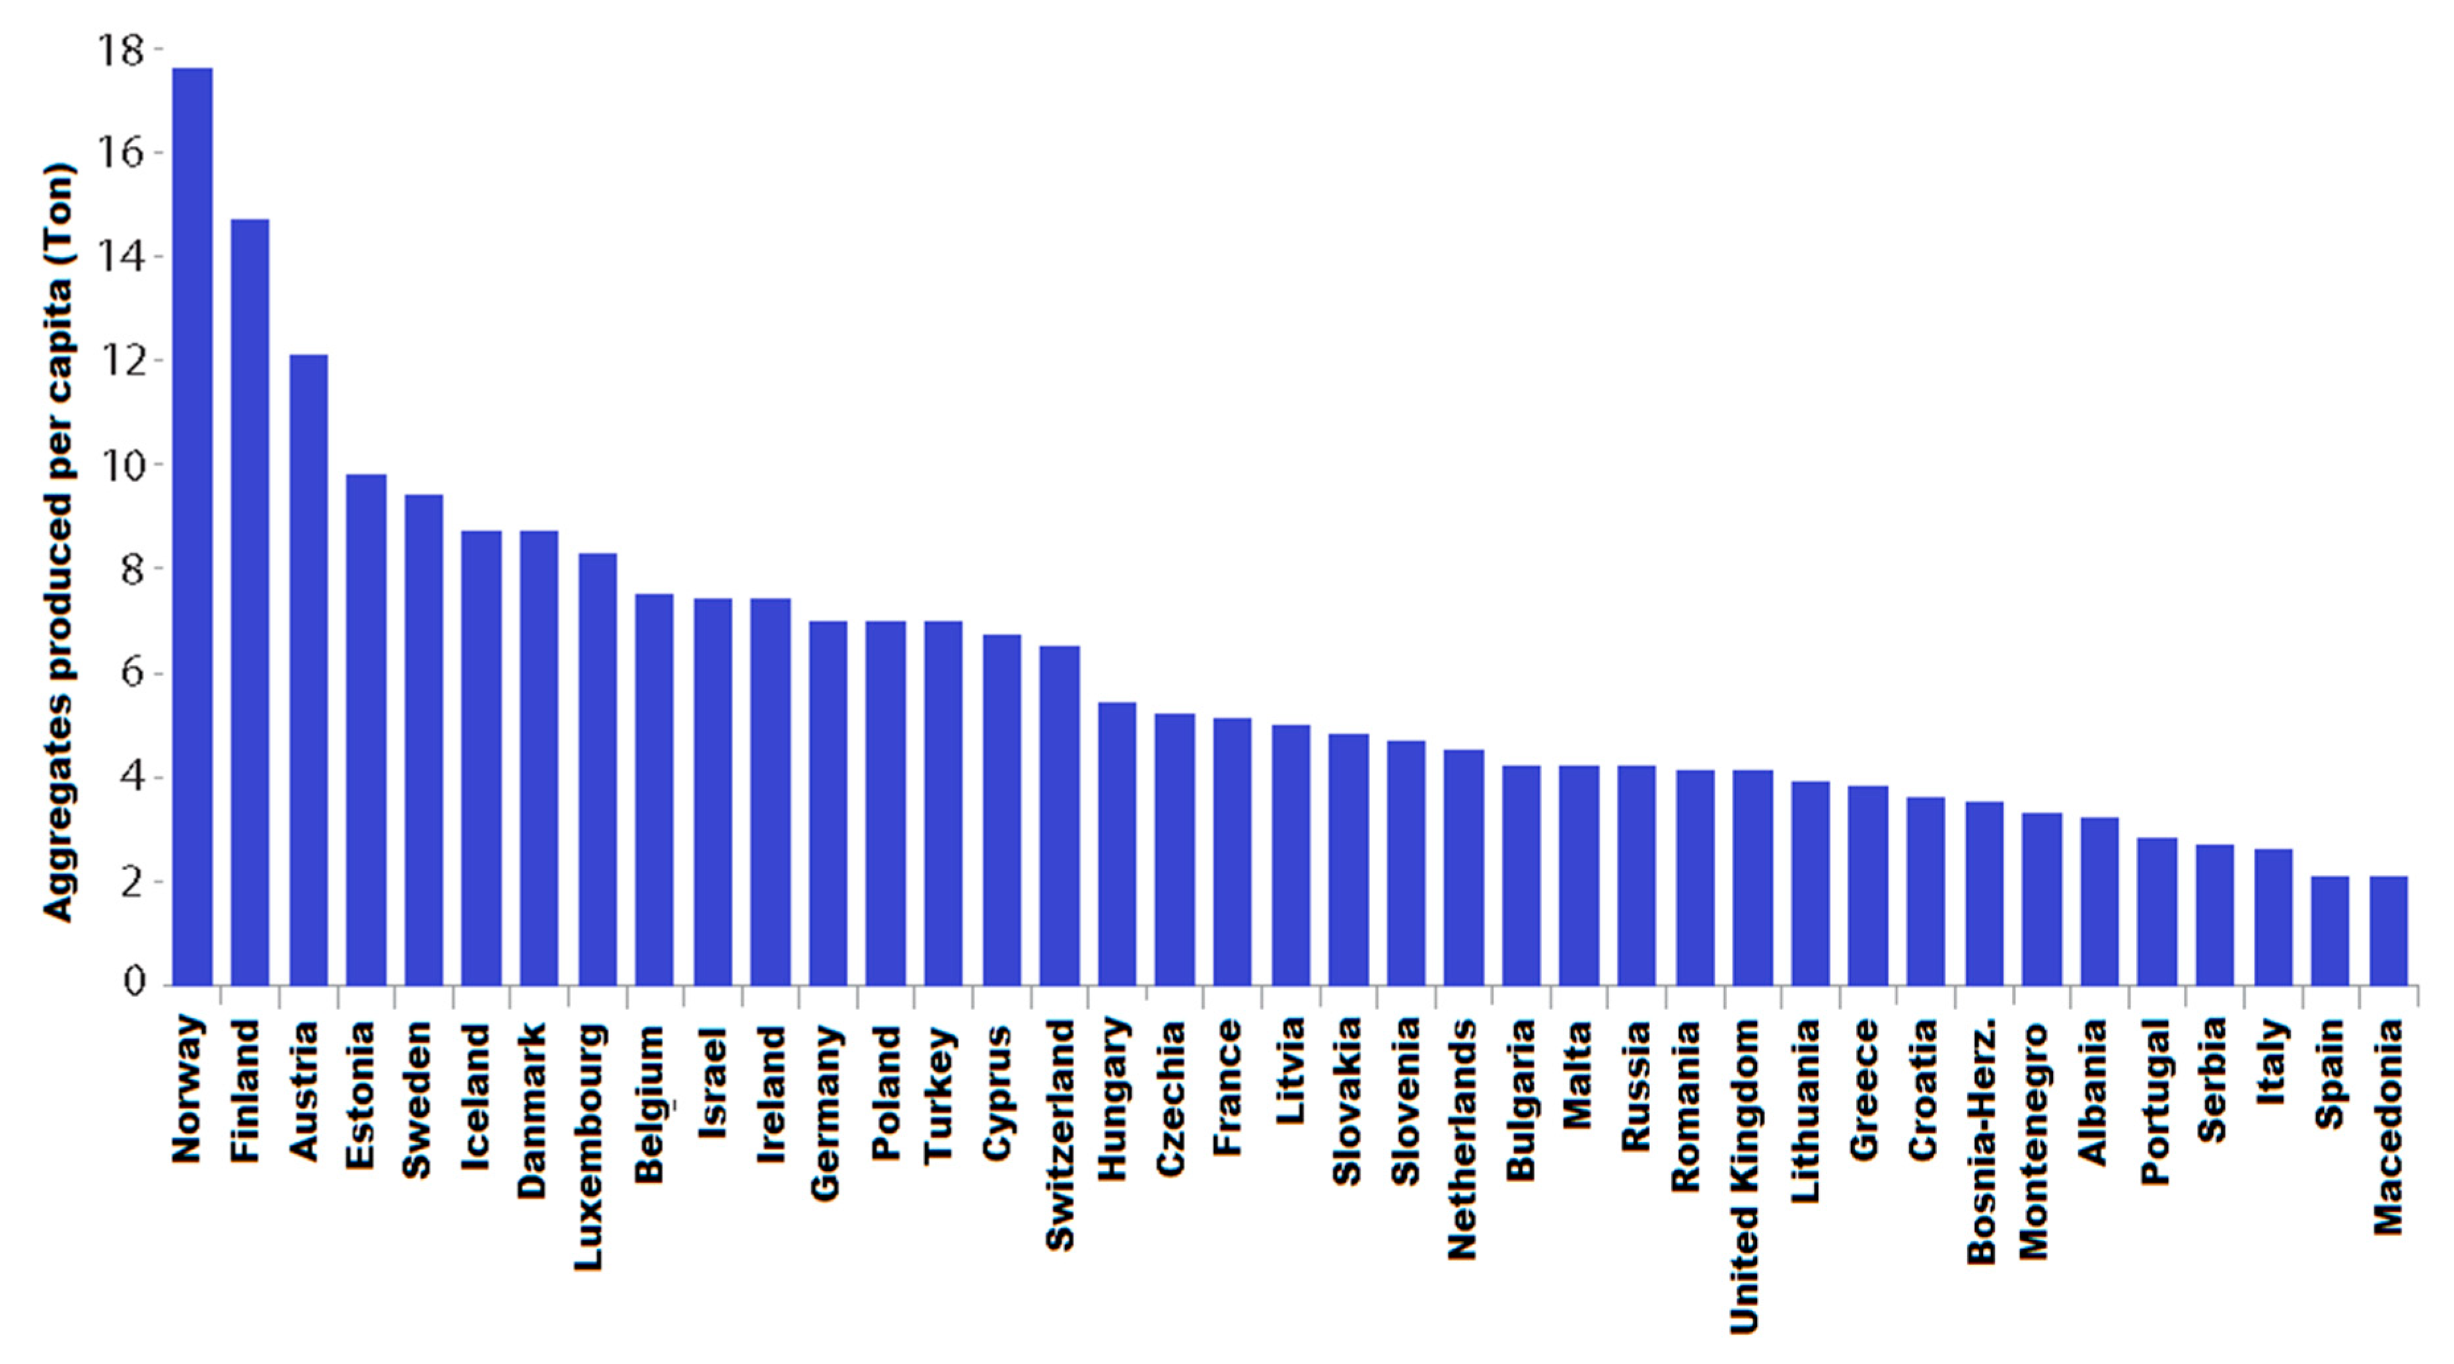
Some Statistics

Slide 6
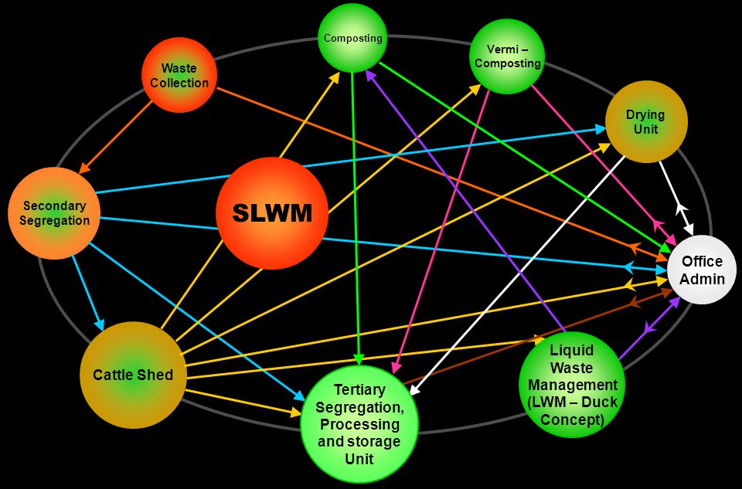
Integrated & sustainable solid & liquid management

Slide 7
Aims & Objectives
High rate biomethanation is more tailored for waste-to-energy projects in India due to the combination of factors like cost, technology, effectiveness and environmental benefits.
The present trend favor material recovery facilities for and a shift away from landfills for MS disposal. Composting is not a WTE option and does not come out as a meritorious waste treatment process.
Technologies such as landfill with gas recovery (LFG) and composting can also become viable options for certain locations (in India) as a short to medium term option. Outsourcing of all activities under Solid Waste Management Services recommended by 12" Finance Commission for using grants ULBS to concentrate on segregation of waste at sourceWaste processing like composting, bio-methanation should be done through public-private partnerships/private sector
Bio-medical waste to be managed by Central Bio-Medical Waste Management Facilities. Various grants like Construction grant, Minimum revenue grant & Operational grant Integrated solid waste Management on PPP basis

Slide 8
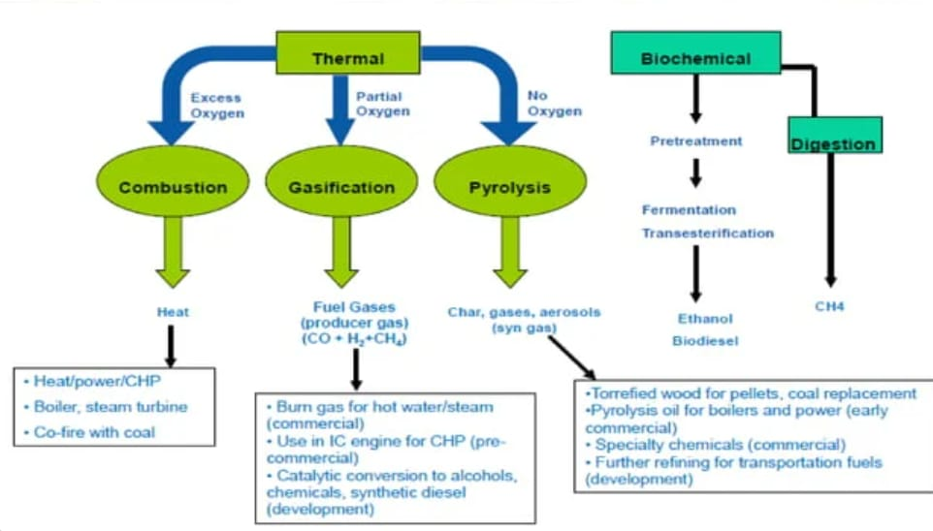
Technology Overview

Slide 9
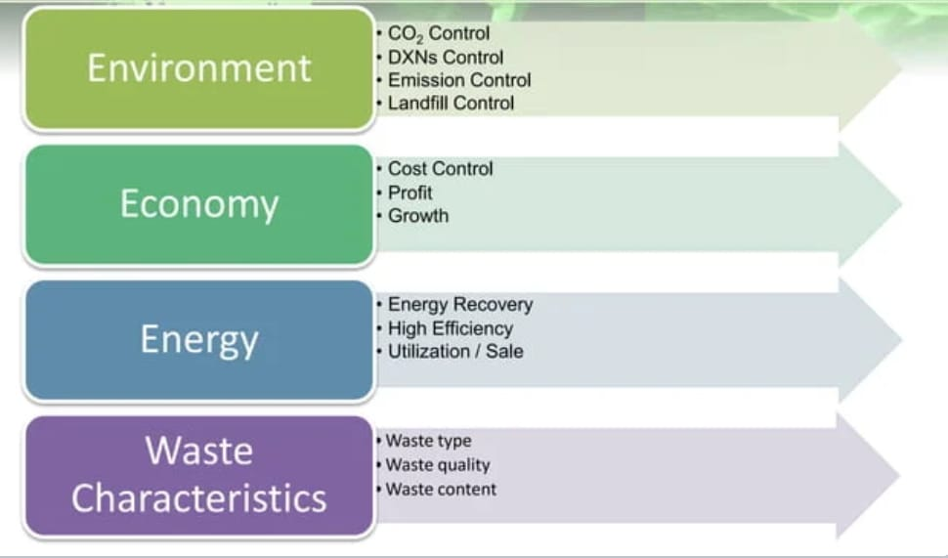
Technology Selection Considerations

Slide 10
Mass & Energy Balance
Technology | Plant capacities( TPD MSW) | Power Generation potential(MW/100 TPD)
Biomethanation | 150,350,500 and 1000 | 1
Landfill with gas recover | 100 | 0.4
Gasification | 500 | 2
Compositing | NA | NA
Incineration | 500 | 1.24

Slide 11
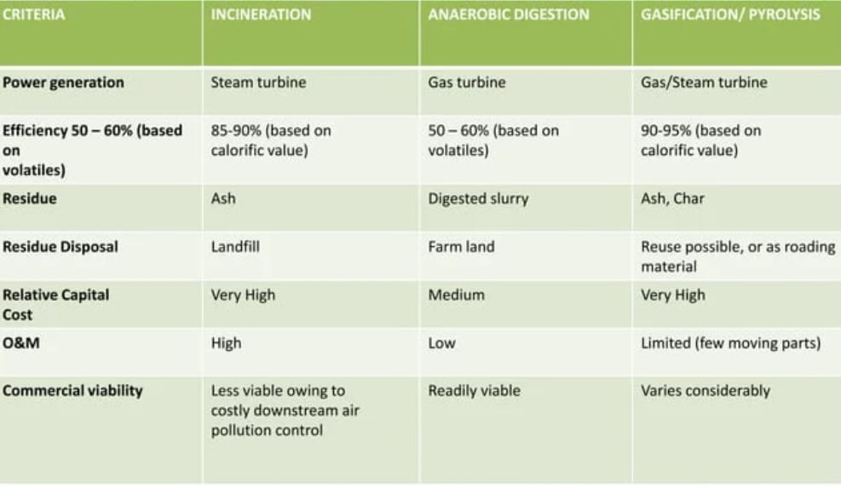
Criteria for selection of WTE technologies

Slide 12
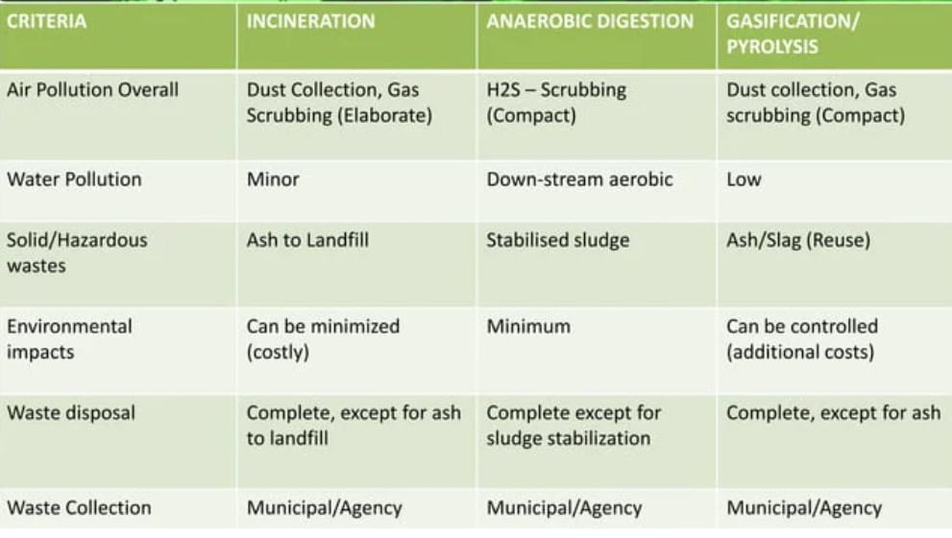

Slide 13
Commercial viability
GOI have provided assistance to the tune of Rs.2500 crores under 12th Finance Commission for SWM. Income Tax relief has also been provided to waste management agencies and Tax free municipal bonds have been permitted by GOI. The 11th Five Year Plan has envisaged an investment of Rs.2212crores for SWM. Private Sector Participation in SWM: The private sector has been involved in door to door collection of solid waste, street sweeping in a limited way, secondary storage and transportation and for treatment and disposal of waste. Cities which have pioneered in PPPs in SWM include Bangalore, Chennai, Hyderabad, Ahmedabad, Surat, Guwahati, Mumbai, Jaipur etc.

Slide 14
Government policies
The establishments providing wastes like industries, hospitals are required to follow the relevant Rules under the Environment Protection Act 1986 as follows:
Hazardous Waste (Management and handling Rules),1989
Bio-medical Waste (Management and Handling Rules) 1998
Municipal Solid Waste (Management and Handling Rules 2000) GOI Initiatives for SWM
Reforms Agenda (Fiscal, Institutional, Legal)
Technical Manual on Municipal Solid Waste Management
Technology Advisory Group on Municipal Solid Waste Management
Inter-Ministerial Task Force on Integrated Plant Nutrient Management from city compost.

Slide 15
Tax Free Bonds by ULBS permitted by Government of India Income Tax relief to Waste Management agencies.
Public-Private Partnership in SWM.
Capacity Building.
Urban Reforms Incentive Fund.
Guidelines for PSP and setting up of Regulatory Authority Introduction of Commercial Accounting System in ULBS & other Sector Reforms.
Model Municipal Bye-Laws framed / circulated for benefit of ULBS for adoption.
Financial Assistance by Government of India 12th Finance Commission Grants.

Slide 16
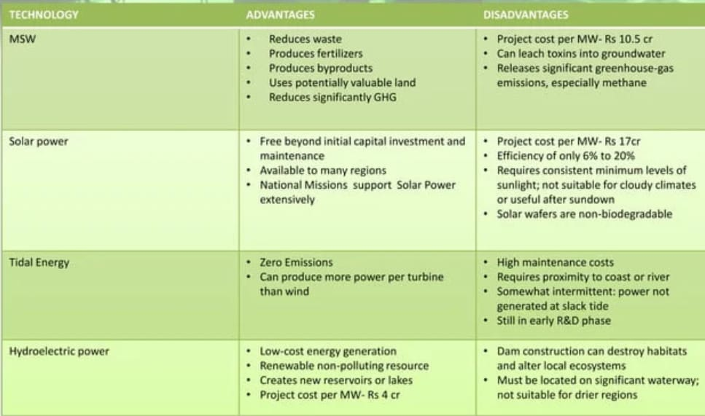
Competing Technologies

Slide 17
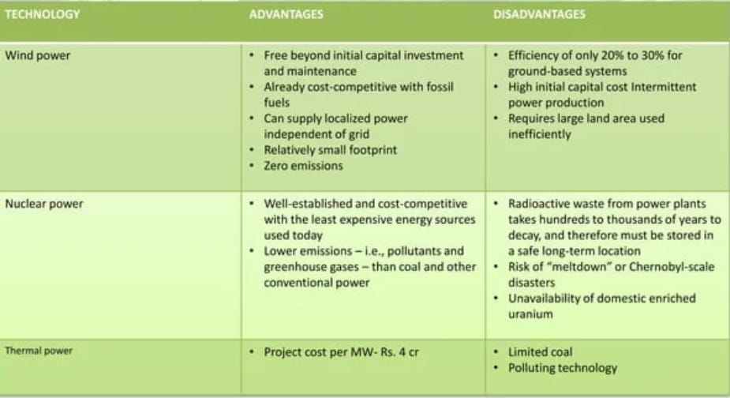

Slide 18
Timarpur Okhla integrated municipal solid waste management project.
Delhi generates 7,000 metric tones (MT) of Municipal Solid Waste (MSW) daily, which is expected to increase to 18,000 MT by 2021. The present landfill sites that are being utilized for disposing the garbage are approaching their full capacity and even with the envisaged capacity addition, the situation is unlikely to improve. The Municipal Corporation of Delhi (MCD) has thus embarked on project to reduce the amount of MSW being disposed in the landfill sites and utilizing the waste for productive purposes such as generation of power from waste. MCD has identified two locations, namely Timarpurand Okhla, for implementing this project.

Slide 19
About the project
The following facilities are to be developed as a part of the integrated municipal waste handling project:
Plants for converting MSW to Refuse Derived Fuel (RDF), capable of processing 1300 TPDat Okhla and 650 TPD at Timarpur
A bio-methanation plant capable of handling of 100 TPD of green waste at Okhla.
A water recovery plant capable of handling up to 6 MLD of treated sewage at the Okhla site for recycling into process water and cooling water
A Power plant with a generation capacity of 16 MW at Okhla.
Transportation of RDF from Timarpur to Okhla for combustion in the boiler of the power plant mentioned above.
The project is registered with the United Nations Framework Convention on Climate Change (UNFCCC) for the Clean Development Mechanism (CDM) to earn 2.6 million Certified Emission Reductions (CERS) over a ten-year period.

Slide 20
Questions yet unanswered!!
What are the reasons for delay in commencement in operations?
What are the reasons for capacity increase from 16MW to 20 MW?Is it a peak load or base load plant?
is it connected to the grid?
What are the constraints with respect to voltage and frequency fluctuations?
How will you account for the supply of waste in monsoon?
What are the waste segregating technologies used, ash and toxic gases disposal.
What are the reasons behind selecting Okhla as plant location, which is away from landfill and very close to residential area?
How are the odour and sanitation aspects being addressed with respect to local resident community?
How is the garbage being stored? Are reserves being maintained?
Do you have scope of increasing the tariff in future?
Environmental clearances and CDM credits were for 16MW, how it will be modified for 20MW.
Is Consolidated Environment impact Assessment (CEIA) being submitted?
Any other managerial hurdles faced in implementation of the project?

Slide 21
How can energy be saved?
Optimize the use of refrigeration and chilling
Regularly maintain boilers and heating distribution systems
Ensure pipework is well insulated
Operate costly compressed air systems efficiently
Improve lighting systems
Correctly size motors and drives for their application
Initiating water saving measures
Use process measurement and control
Integrate energy management systems
Consider Combined Heat and Power (CHP)

Slide 22
Pros
Incentives and cash flow through carbon credits.
Reduced waste & increased use of land due to decrease in land fills (As MSW increase at approx 1-1.33%)
Reduction in release of GHG and toxins into water.
No additional fuel required to run the plant as it can support its power requirement
Supply linkage issues don't exist after tie-up's with ULB'S.
Commercially viable in many countries.
Mature Technology.
Increase in city sanitation
Control of emission of toxic gasses and particulates in the atmosphere can be done using filters.
Done on small fronts.
Support of finance by Govt.
Energy prices on par with conventional sources.
Long term price stability
Control of waste stream
Metal Recovery after incineration

Slide 23
Cons
Absence of segregation of waste at source
Lack of technical expertise and appropriate institutional arrangement
Unwillingness of ulbs to introduce proper collection, segregation, transportation and treatment/disposal systems
Indifferent attitude of citizens towards waste management due to lack of awareness
Lack of community participation towards waste management and hygienic conditions
Need to rationalize tariff and user charges
Complexity in unbundling urban service delivery

Slide 24
Recommendations
High rate biomethanation is more tailored for waste-to-energy projects in India due to the combination of factors like cost, technology, effectiveness and environmental benefits
The present trend favour material recovery facilities for and a shift away from landfills for MSWdisposal.
Composting is not a WTE option and does not come out as a meritorious waste treatment process.
Technologies such as landfill with gas recovery (LFG) and composting can also become viable options for certain locations (in India) as a short to medium term option.
Outsourcing of all activities under Solid Waste Management Services recommended by 12" Finance Commission for using grants
ULBS to concentrate on segregation of waste at source.
Waste processing like composting, bio-methanation should be done through public-private partnerships/private sector
Bio-medical waste to be managed by Central Bio-Medical Waste Management Facilities.
Various grants like Construction grant, Minimum revenue grant & Operational grant
Integrated solid waste Management on PPP basis

Slide 25
Conclusion
WTE contributes significantly to a CE by generating energy and promoting sustainability. This chapter first investigated Chinese waste by providing a comprehensive analysis of the current status of waste and WTE management. Literature reviews of waste by types and management options were then presented. The SWOT of WTE in China were analyzed and discussed. The main findings and policy implications are as follows:

Slide 26
First, along with urbanization, population growth, and industrialization, the volume of Chinese waste increased from 152,145 million tons in 2007 to 215,210 million tons in 2017. With the rapid growth in the waste amount, the treatment rate of consumption on wastes increased steadily, rising from 62.0% in 2007 to 97.7% in 2017. The landfill is the traditional and the dominant option of waste management, at 120.37 million tons in 2017, followed by incineration (84.63 million tons) and composting (5.33 million tons). This shows a positive trend of waste treatment over the last decade in China and provides opportunities for the WTE system.

Slide 27
Second, there are three cities whose industrial solid wastes comprehensively utilized ratio reached 100% in 2017, namely Dayong, Haifeng, and Zaozhuang. One hundred and four cities could utilize more than 90% of industrial solid wastes (Fig. 2.3). However, 46 cities, such as Taiyuan, Jixi, and Jilin, only utilized less than 50% of industrial solid wastes in 2017. As such, there are still great disparities in terms of the utilization of industrial solid waste among cities. The ratio of industrial solid wastes comprehensively utilized in the eastern region was highest. An approach for removing the technology diffusion barriers among cities or regions should be carried out to accelerate the process of management experience. The spillover of knowledge and technology allows a city or region to take advantage of resources to promote WTE development in a CE effectively and rapidly.

Slide 28
Third, China has great potential to accelerate the establishment of a WTE system and the newly launched garbage classification in 2019 provides opportunities to overcome some weaknesses and threats. Waste treatment of China is still in the development stage, and we need to pay attention to some technical strengthening and management details. Pretreatment technology is a significant part of WTE management. Garbage classification is the most important content of pretreatment technology. Even though 46 key cities in China have been listed in the pilot program of garbage classification in 2019, classification and placement of solid waste are still far less than sufficient. Policymakers should increase the public’s awareness of garbage classification. The success of this program has a great impact on the perfecting of the WTE system.

Slide 29
References
https://www.sciencedirect.com/topics/engineering/waste-to-energy#:~:text=Waste%20to%20energy%20achieves%20a,combustion%20process%20effectively%20eliminates%20all
https://www.centrica.com/stories/2017/10-ways-to-reduce-waste-energy-in-your-production-line/
https://slideplayer.com/slide/3811124/
https://en.wikipedia.org/wiki/Waste-to-energy

